Slide 1
Clustering: k-Means, Hierarchical

Slide 2
Introduction
Example

Slide 3
Introduction
Cluster
  Group of the similar objects
  Good Cluster?
    High Intra-cluster similarity
    Low Inter-cluster similarity
Clustering
  Special method of classification
    No pre-defined group information(classification needs)
    Learning by observation
  Class discovery

Slide 4
k-Means
Use gravity center of the objects
Algorithm
  Input : k (the number of cluster), Set V of n objects
  Output : A set of k clusters which minimizes the sum of distance error criterion
  Method :
    Choose k objects as the initial cluster centers; set i=0
    Loop for each object, p, in V
      For each object, p, in V, ind the NearestCenter(p), and assign p to it
      Compute mean of cluster as the new centers

Slide 5
k-Means
Example
  Initially, select 3 objects (or random points) as the center of 3 clusters

Slide 6
k-Means
Example
  Assign all objects to the nearest cluster center

Slide 7
k-Means
Example
  Re-calculate the center of clusters based on the its objects

Slide 8
k-Means
Example
  Re-Assign all objects to the nearest cluster center

Slide 9
k-Means
Example
  Re-calculate the center of clusters based on the its objects

Slide 10
k-Means
Strength
  Relatively efficient: O(tkn)
    n: # of objects
    k: # of clusters
    t: # of iterations, Normally, k, t << n
Weakness
  Applicable only when mean is defined
  Need to specify k in advance
  Unable to handle noisy data and outliers
  Not suitable to discover clusters with non-convex shapes

Slide 11
Hierarchical Method
Algorithm for Agglomerative
  Input : Set V of objects
  Regard each object as a cluster
  Loop until the number of clusters is one
  Calculate inter-cluster similarities of current clusters
  Merge by the fusion of the most similar pair of clusters

Slide 12
Hierarchical Method
Example

Slide 13

Hierarchical Method
Example
  Single-Linkage

Slide 14

Hierarchical Method
Example
  Complete-Linkage

Slide 15
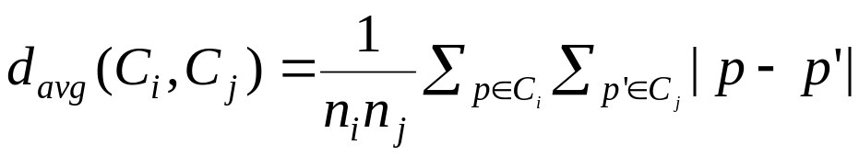
Hierarchical Method
Similarity method
  Single-Linkage
  Complete-Linkage
  Average-Linkage
Single-Link
C_{j}
C_{i}
Complete-Link

Slide 16
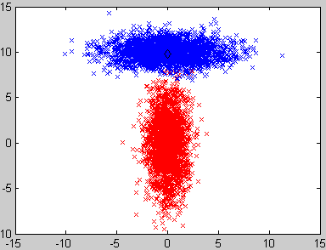
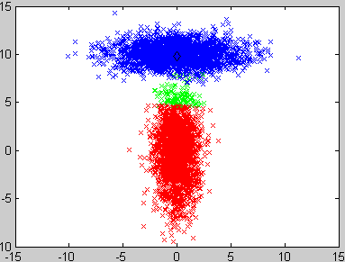
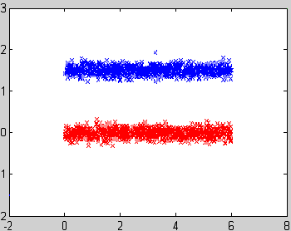
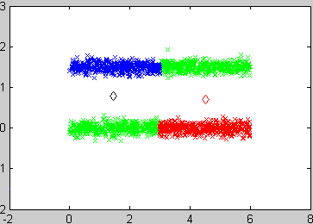
Problems of k-Means
Clusters with non-spherical shapes (ellipsoidal shape)
Ellipsoids
Linear Varieties (lines)
N=5000, C=2
N=2000, C=2

Slide 17
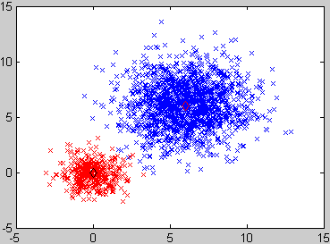

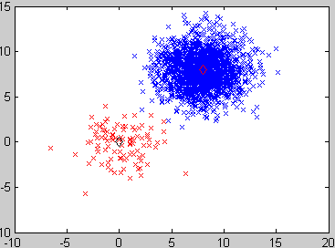
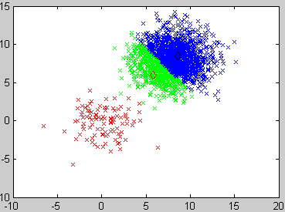
Problems of k-Means
Clusters with different sizes and densities
N=2000, C=2
N=2000, C=2

Slide 18
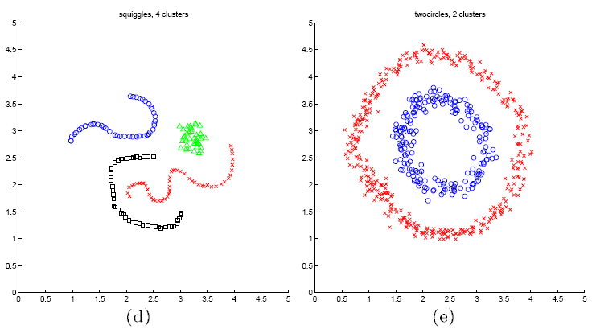
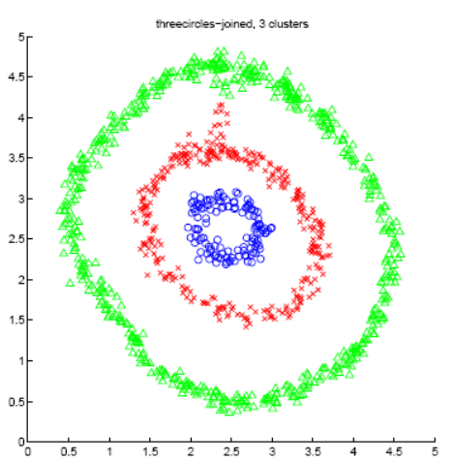
Problems of k-Means
Non-Convex Clusters
=> A Simple Idea: …
=> Spectral Clustering
  Convert the data distribution into a graph
  Apply the spectral clustering which is based on SVD

